Slide 1
INTRODUCTION TO EPIGENOME-WIDE ASSOCIATION STUDIES (EWAS)
5. BIOLOGICAL INTERPRETATION OF FINDINGS
(THEORY)

Slide 2
EPIGENOME-WIDE ASSOCIATION STUDY (EWAS)
Workflow
Scientific question
Study population
Biological sample
DNA methylation data acquisition
Quality control of DNA methylation data
Epigenome-wide association study (EWAS)
Meta-EWAS or replication / validation
Biological interpretation

Slide 3
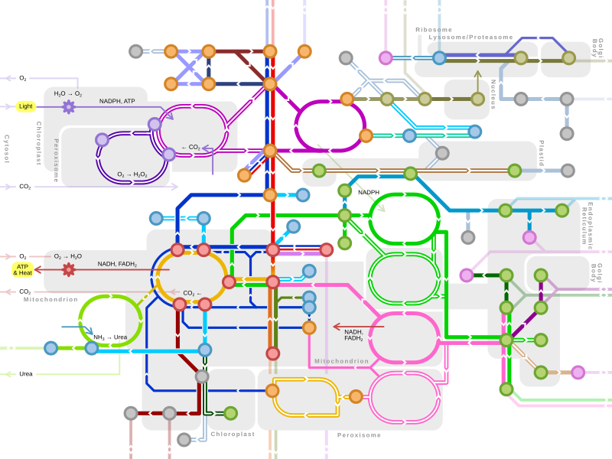
EPIGENOME-WIDE ASSOCIATION STUDY (EWAS)
Workflow
Scientific question
Study population
Biological sample
DNA methylation data acquisition
Quality control of DNA methylation data
Epigenome-wide association study (EWAS)
Meta-EWAS or replication / validation
Biological interpretation

Slide 4

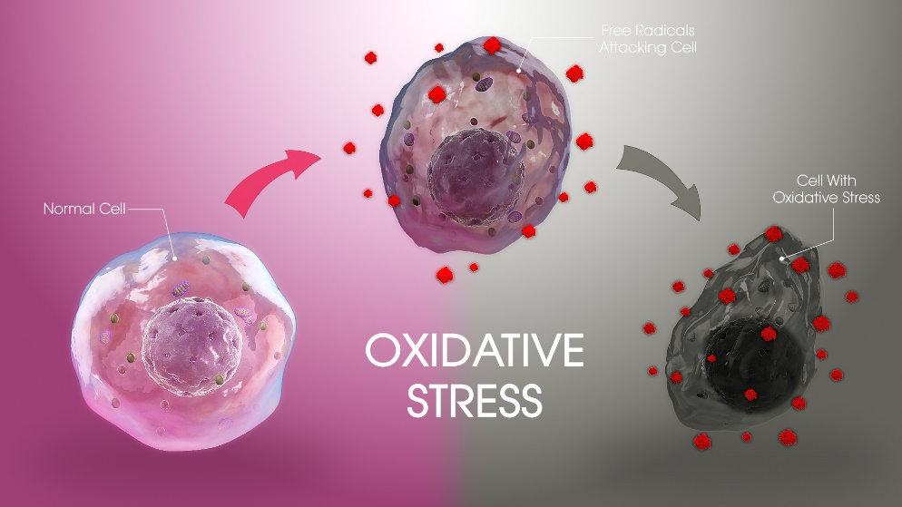
8. BIOLOGICAL INTEPRETATION
Which is the aim?
To interpret which are the genes or biological functions affected.
Tobacco smoking
Inflammation
Significant CpGs

Slide 5
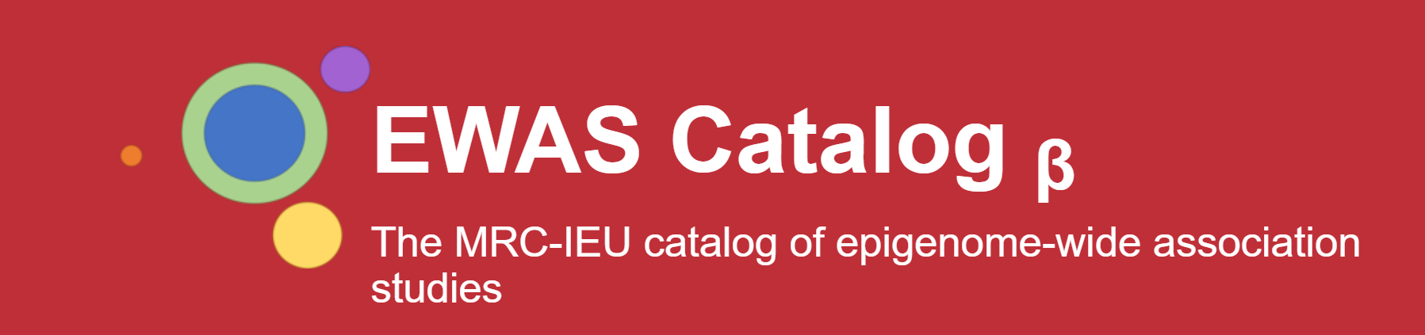
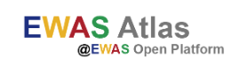
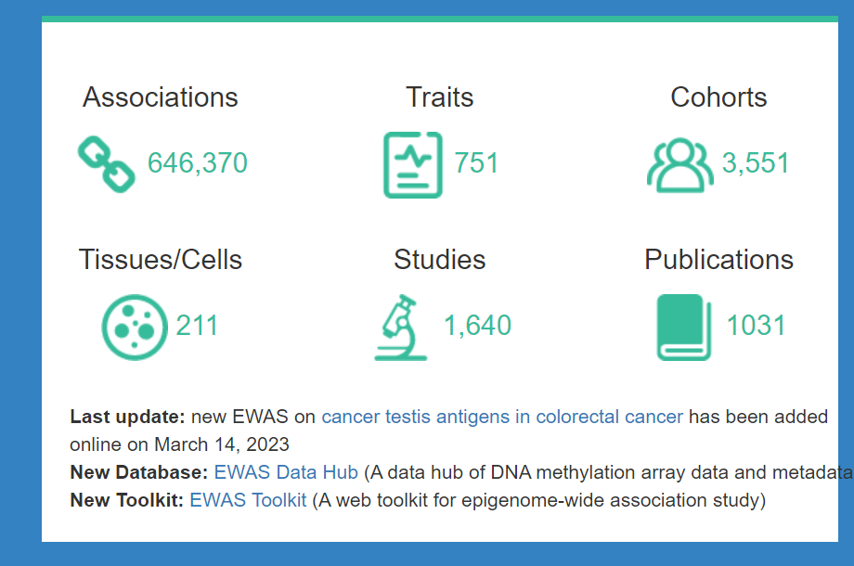
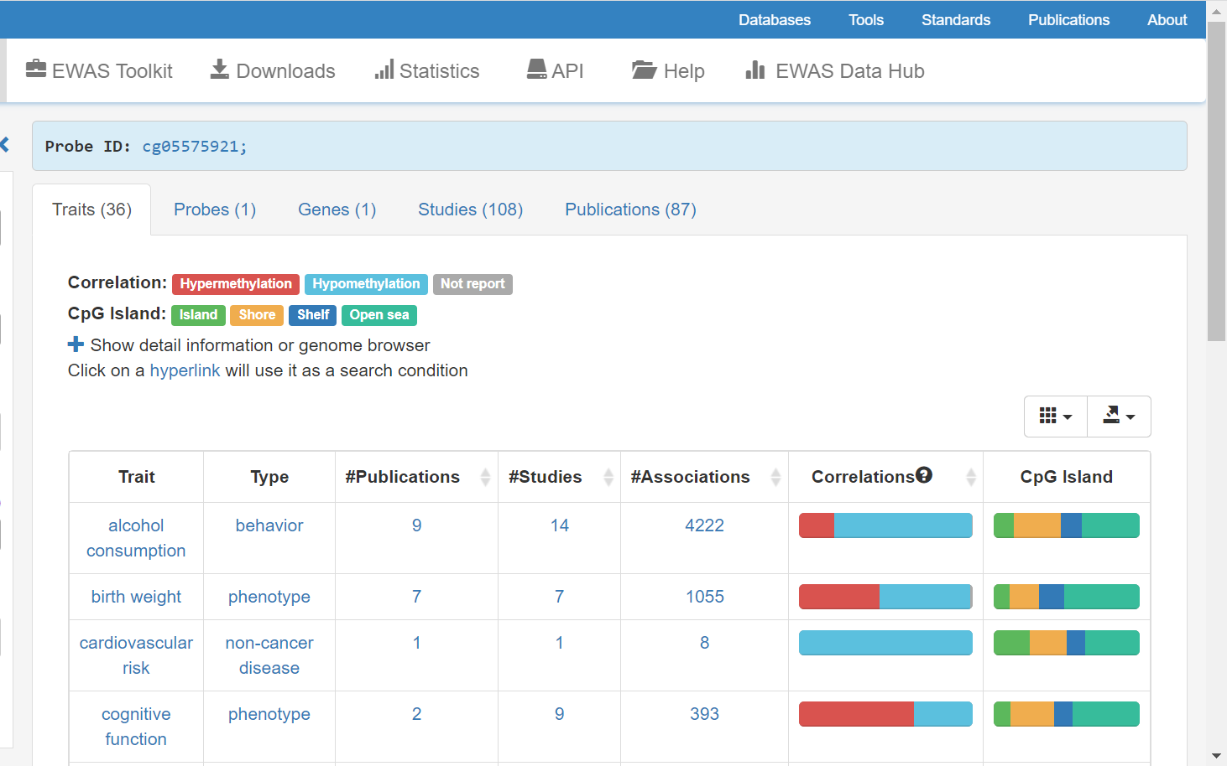
8. BIOLOGICAL INTEPRETATION
Previous reported associations
Pubmed
EWAS catalog (http://www.ewascatalog.org/)
EWAS atlas (https://ngdc.cncb.ac.cn/ewas/atlas)

Slide 6
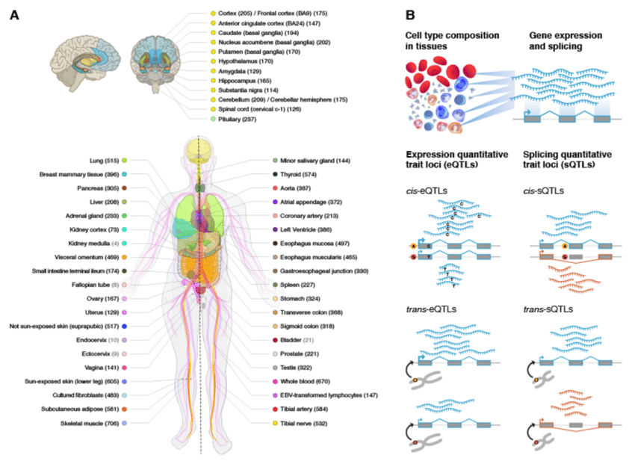
8. BIOLOGICAL INTEPRETATION
Methylation profile across tissues
The Genotype-Tissue Expression (GTEx)
(https://gtexportal.org/home/)
Aim: comprehensive public resource to study tissue-specific gene expression and genetic regulation
Now it has incorporated methylation data (WGBS and EPIC array)!

Slide 7
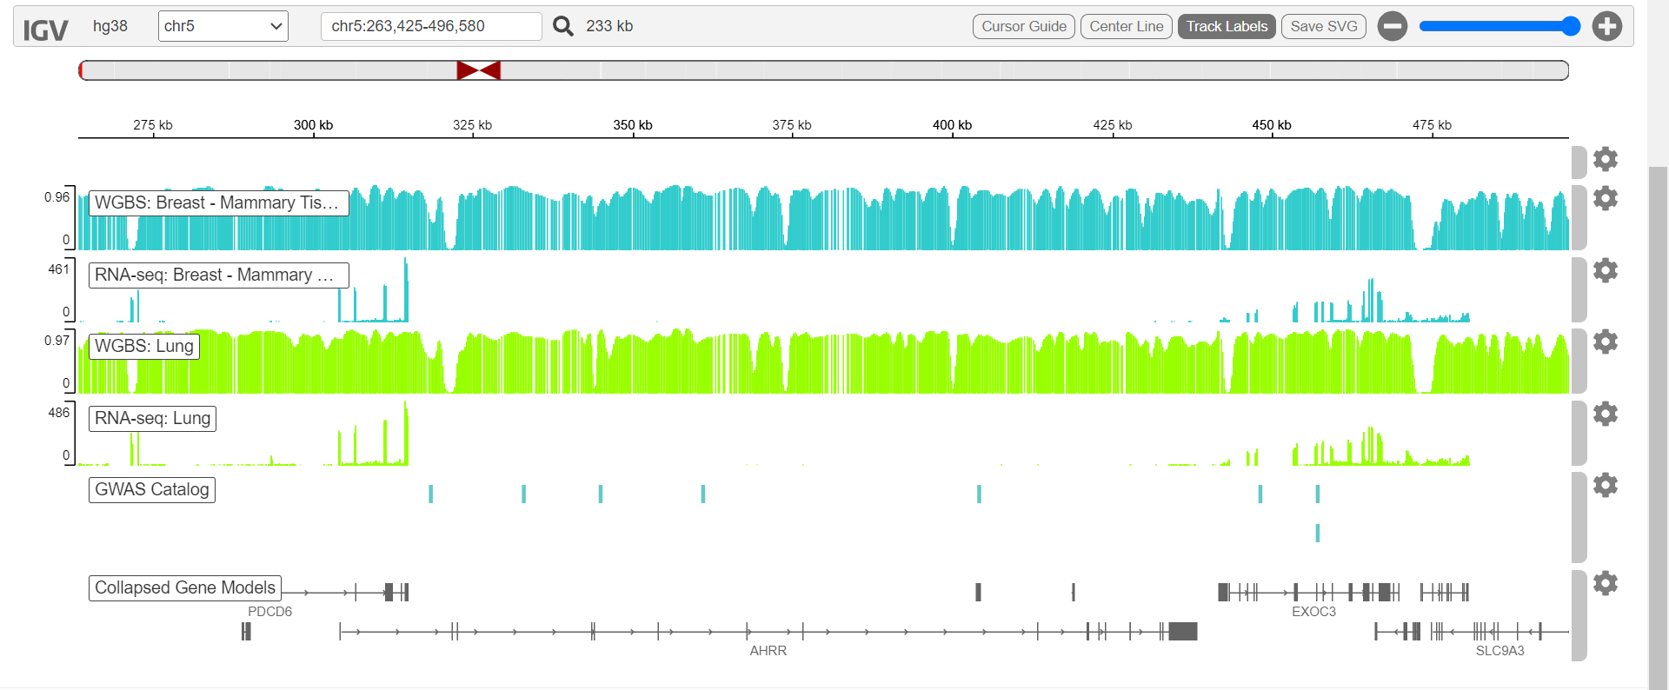
8. BIOLOGICAL INTEPRETATION
Methylation profile across tissues
The Genotype-Tissue Expression (GTEx) project (https://gtexportal.org/home/)

Slide 8
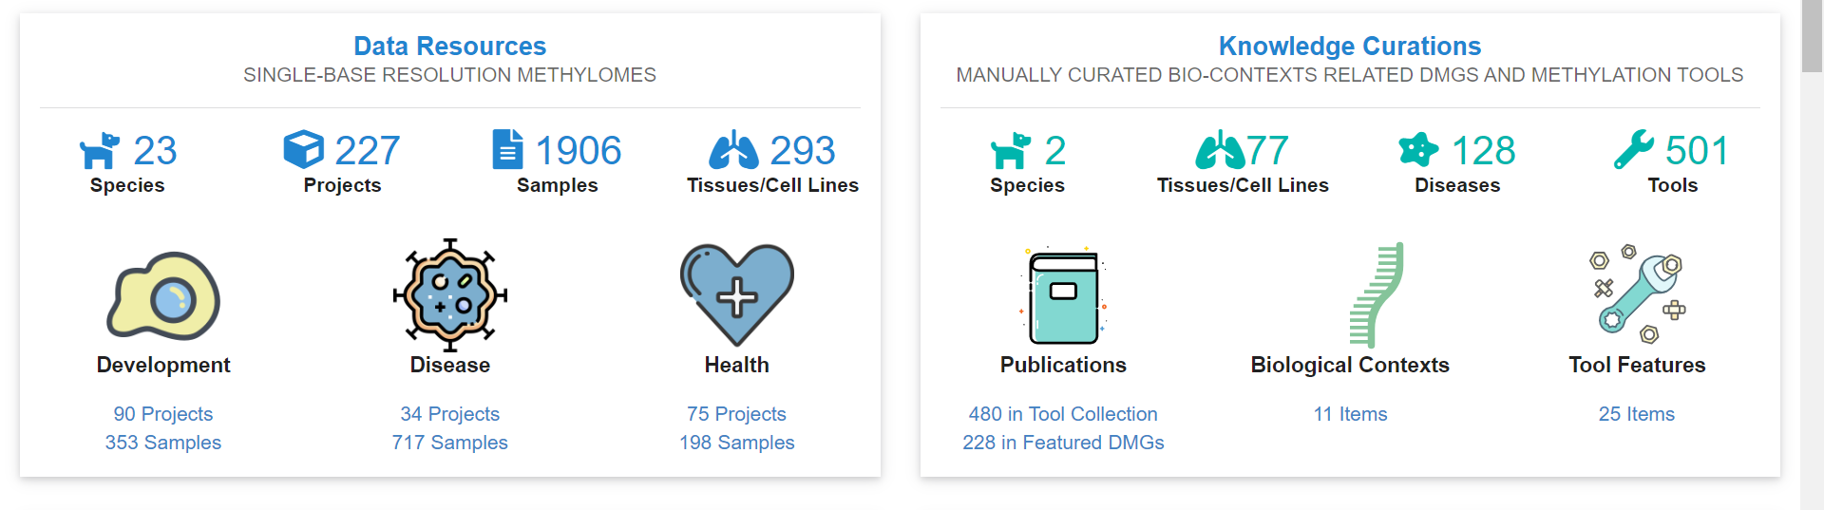
8. BIOLOGICAL INTEPRETATION
Methylation profile across species
MetBank (https://ngdc.cncb.ac.cn/methbank/)

Slide 9
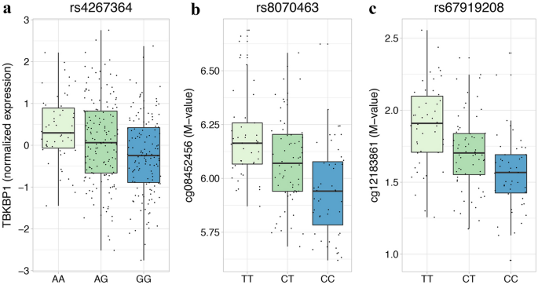
8. BIOLOGICAL INTEPRETATION
Methylation quantitative trait locus (mQTL)
Genetic variation (SNP) associated with DNA methylation status.
Tissue specific
mQTL catalogues for blood
GoDMC (http://mqtldb.godmc.org.uk/)
ARIES (http://www.mqtldb.org/)

Slide 10
8. BIOLOGICAL INTEPRETATION
Annotation of CpGs to genes
Positional annotation
“IlluminaHumanMethylationEPICanno.ilm10b2.hg19“ R package
1500 upstream and 3’UTR downstream the gene
Functional annotation
Based on methylation-expression correlations (eQTM)
TSS Gene
CpG
TSS Gene
CpG

Slide 11
8. BIOLOGICAL INTEPRETATION
Expression quantitative trait methylation (eQTM)
Specific position of the genome whose DNA methylation status is associated with the expression of a given gene.
Cis and trans
Catalogues
Tissue specific
Mostly in blood
HELIX cis eQTM catalog in child blood
(https://helixomics.isglobal.org/)
cis eQTM
TSS
CpG
CpG
trans eQTM

Slide 12
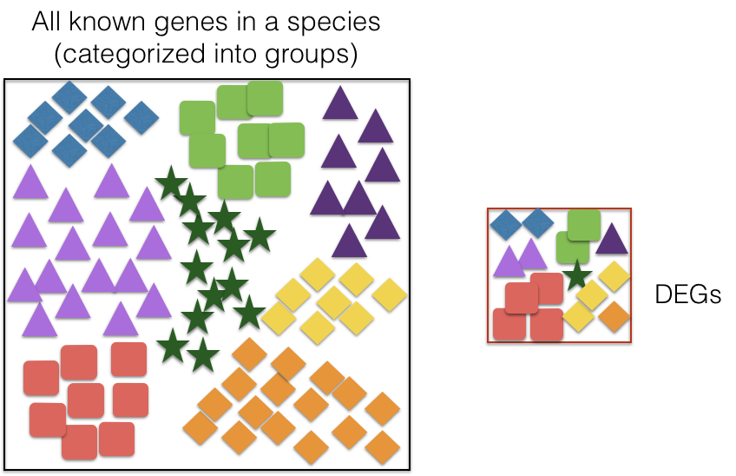
8. BIOLOGICAL INTEPRETATION
Functional enrichment analyses

Slide 13
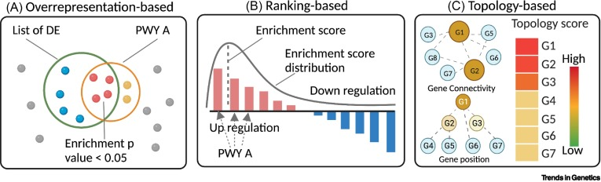
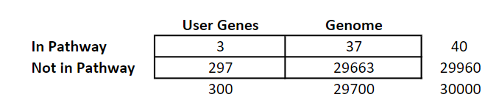
8. BIOLOGICAL INTEPRETATION
Functional enrichment analyses approaches
Overrepresentation method
Contingency table
Test: Chi2, Fisher, …
Correction for multiple-testing
Correction for array bias (missmethyl R package)

Slide 14
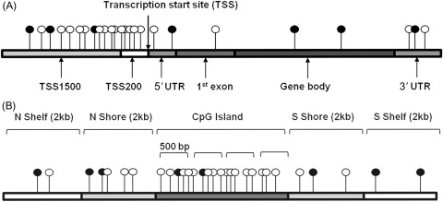
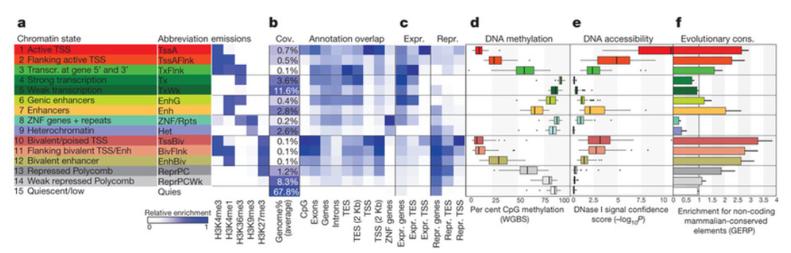
8. BIOLOGICAL INTEPRETATION
DB molecular enrichment (CpG list)
Relative gene positions (Illumina)
CpG island relative positions (Illumina)
Chromatin states (ROADMAP)
Imprinted regions (literature)
Tissues and cell types
…

Slide 15
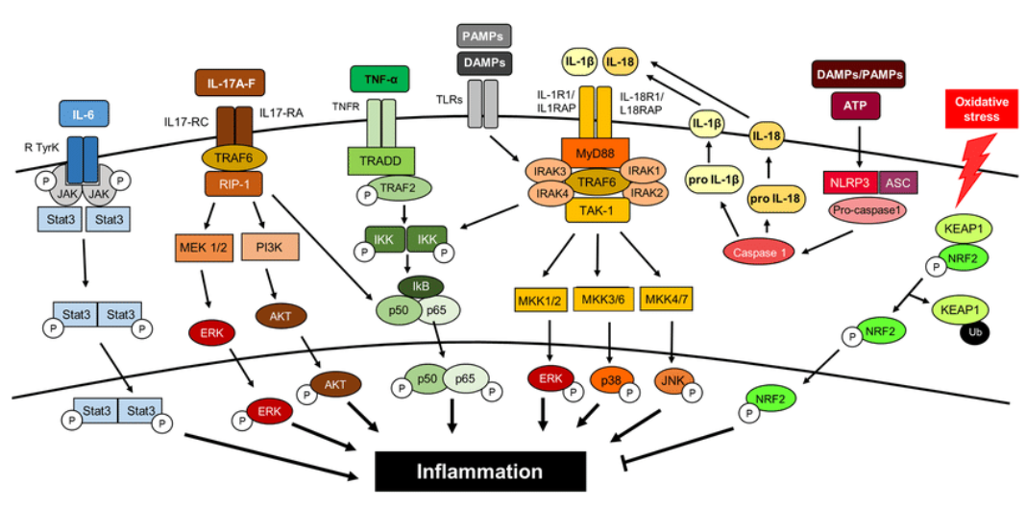
8. BIOLOGICAL INTEPRETATION
Databases for gene-set enrichment (gene list)
Gene ontology (GO) terms (http://geneontology.org/)
Molecular function (ie. ubiquitinization)
Cellular component (ie. cell membrane)
Biological process (ie. DNA repair)
Pathways or gene-sets
Kyoto Encyclopedia of Genes and Genomes
(https://www.genome.jp/kegg/)
Reactome (https://reactome.org/)
Diseases
DisGeNET (https://www.disgenet.org/)
Tissues and cell types
Human Protein Atlas (https://www.proteinatlas.org/)
Transcription factor regulation
ENCODE and ChEA Consensus TFs from ChIP-X
…

Slide 16
8. BIOLOGICAL INTEPRETATION
Tools
CpG list
eFORGE (https://eforge.altiusinstitute.org/): CpG list -> tissue
eFORGE TF (https://eforge-tf.altiusinstitute.org/): CpG list -> transcription factors
missmethyl R package: CpG list -> gene list (internally) -> gene-set
-> controls for array bias
Gene list
ClusterProfiler R package: gene list -> gene-set, GO-terms
enrichR (https://maayanlab.cloud/Enrichr/): gene list -> gene-set, disease, transcription factors …
ConsensusPath (http://cpdb.molgen.mpg.de/): gene list -> gene-set and others
DAVID (https://david.ncifcrf.gov/): gene list -> gene-set

Slide 17
INTRODUCTION TO EPIGENOME-WIDE ASSOCIATION STUDIES (EWAS)
5. BIOLOGICAL INTERPRETATION OF FINDINGS
(THEORY)

Slide 18
FUNCTIONAL ENRICHEMENT ANALYSIS OF CURRENT AND FORMER SMOKING
Data: results from meta-analysis
Array: 450K
Tissue: blood
Ancestry: White European
Sex: males and females
Smoking: never, former, current
Age: yes
Array batch: yes
Cells: yes
Input (current and former): results meta-analysis
Output (current and former): list FDR CpG, list FDR genes, gene-set, GO terms, and tissue/cell type enrichment plot and table
Tool: annotation / eFORGE (online), ClusterProfiler R package TRANSCRIPTION FACTORS?
Questions:
1. Which are the enriched tissues in current smokers? and in former smokers?
2. Which are the enriched GO terms in current smokers? and in former smokers?
3. Which are the enriched KEGG pathways in current smokers? and in former smokers?

Slide 19
INTRODUCTION TO EPIGENOME-WIDE ASSOCIATION STUDIES (EWAS)
5. CLOUSURE OF THE COURSE AND COMMENTS

Slide 20
COMMENTS OR QUESTIONS
Any comments or questions?
Teachers:
Juan Ramon González (juanr.gonzalez@isglobal.org)
Mariona Bustamante (mariona.bustamante@isglobal.org)
Laura Balagué (laura.balague@isglobal.org)
Sofía Aguilar (sofia.aguilar@isglobal.org)

Slide 21

THANKS FOR TAKING PART IN THE COURSE!

